Slide 1








BANGLADESH UNIVERSITY OF PROFESSIONALS
PROJECT
STUDENT PERFORMANCE
IMPLEMENTING LOGISTIC REGRESSION
PRESENTED BY
SAKIB MIZAN
ID: 2154901009

Slide 2


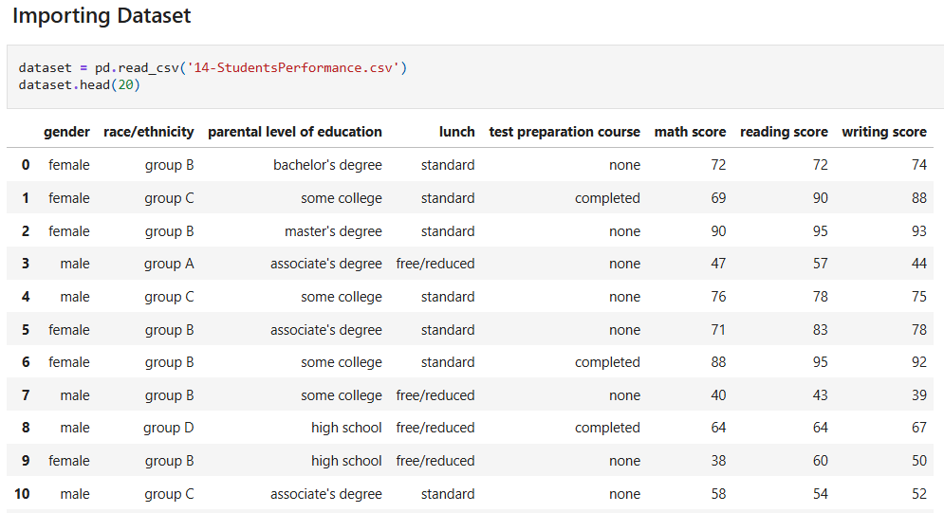


DATASET ANALYSIS
Dataset: Students Performance
Objective: Implementing Logistic Regression to predict Test Preparation Course
Size: 1000 rows & 8 columns
Target Class: Test Preparation Course
Features: Gender, Group/Ethnicity, Parental Level Education, Lunch, Test Preparation Course, Math score, Reading Score, Writing Score

Slide 3

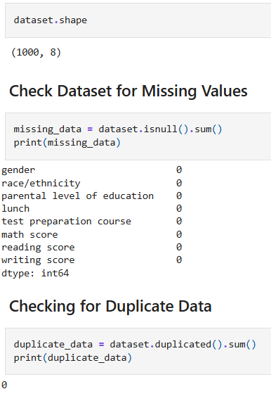
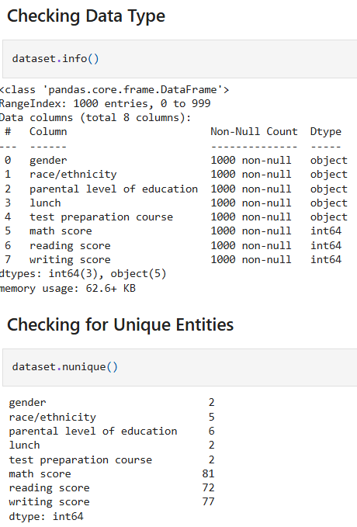


DATASET ANALYSIS
No Missing Values
No Null Values
No Duplicate Data
5 Categorical Features
3 Numerical Features
2 Unique Entities in Target Class

Slide 4
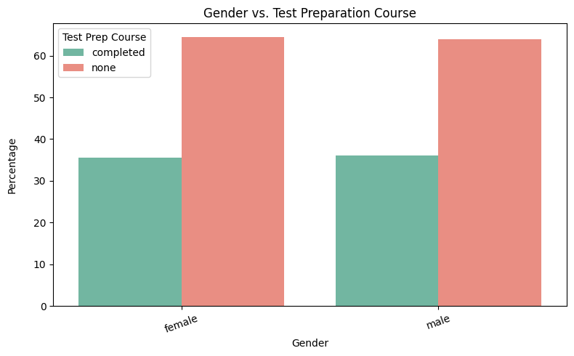
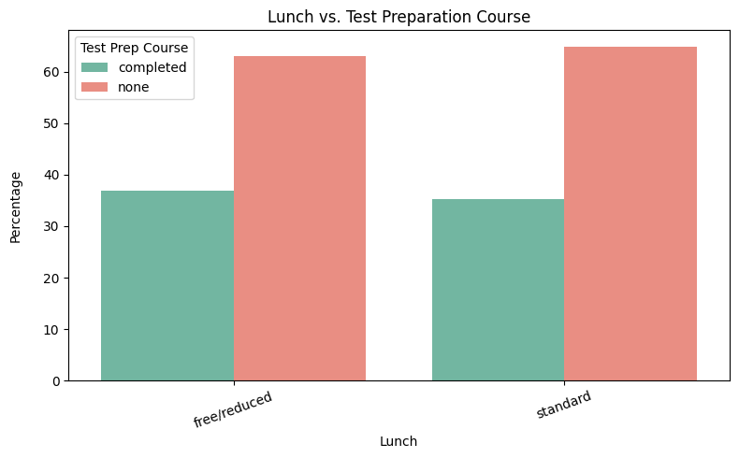
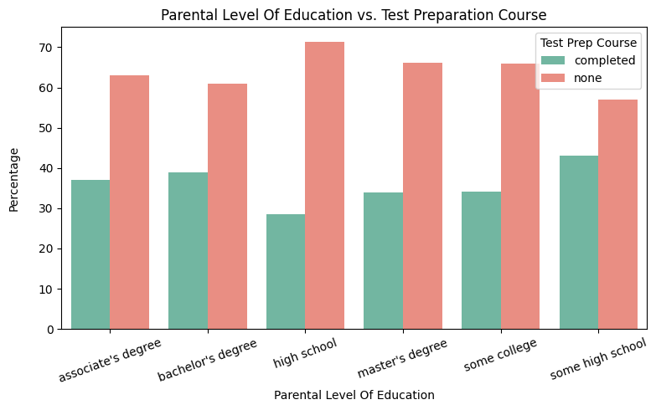
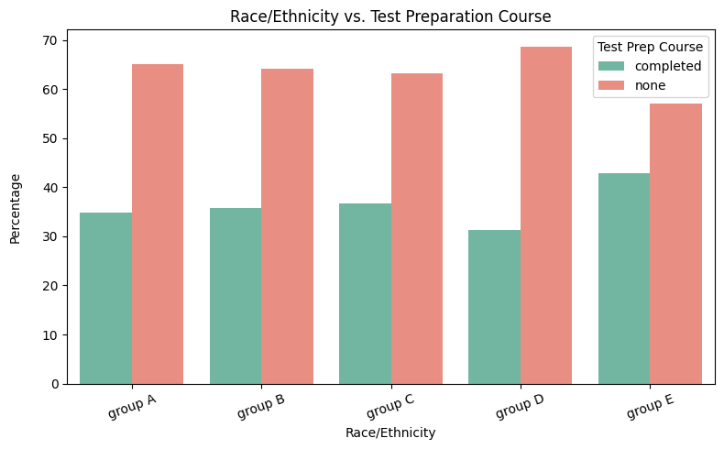
DATASET ANALYSIS

Slide 5
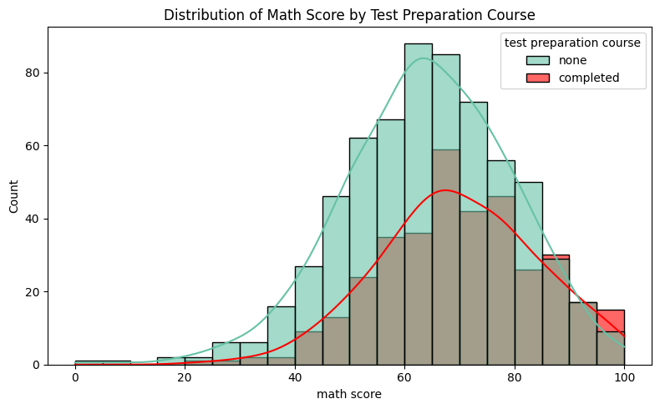
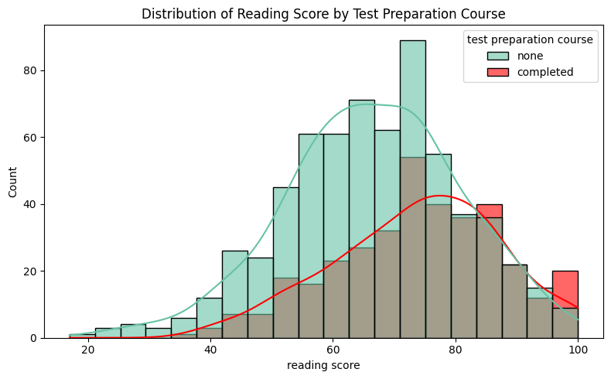
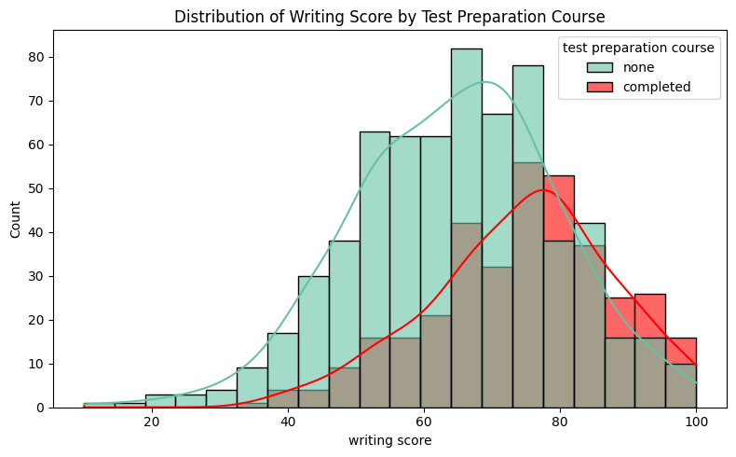
DATASET ANALYSIS

Slide 6
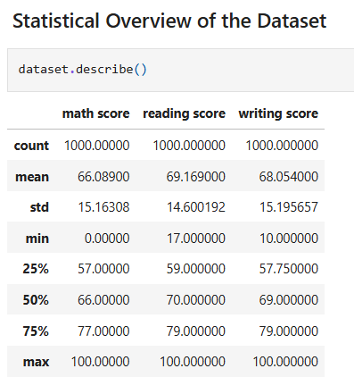
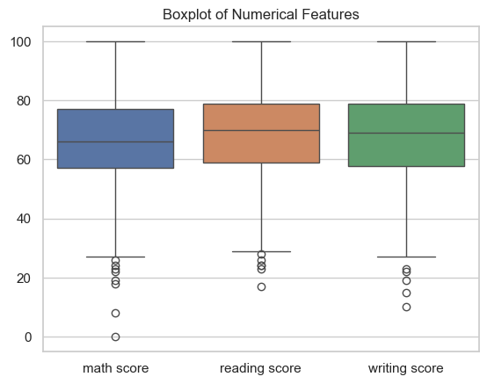
BOXPLOT VISUALIZATION

Slide 7
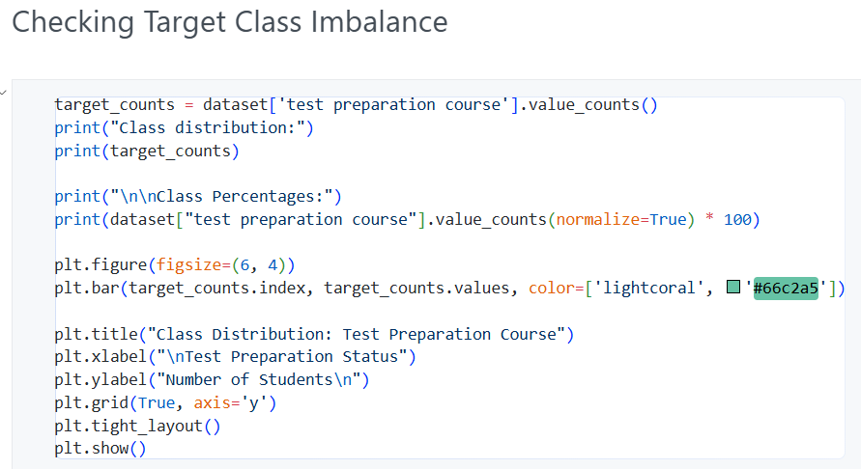
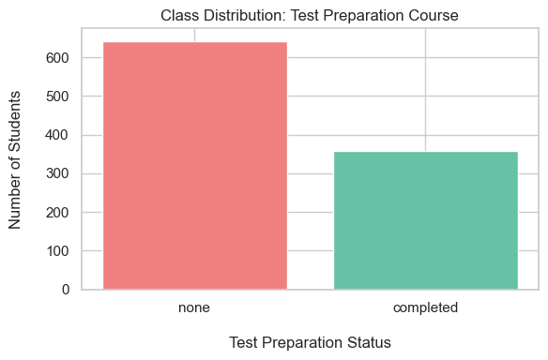
IMBALANCED?
Target Class: Test Preparation Course
Class Distribution:
None: 642 (≈ 64%)
Completed: 358 (≈ 36%)

Slide 8
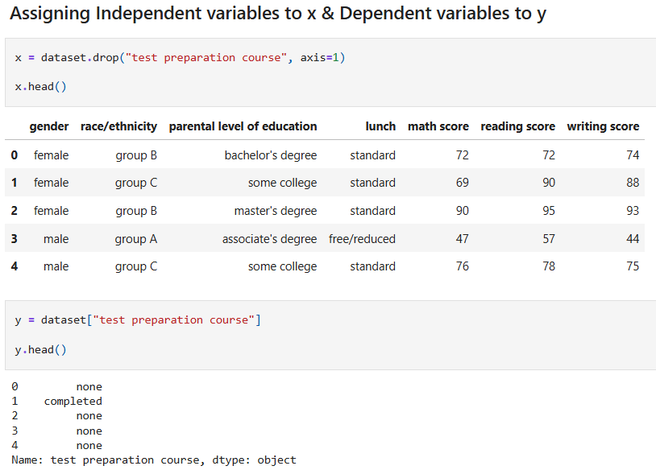
PREPROCESSING

Slide 9
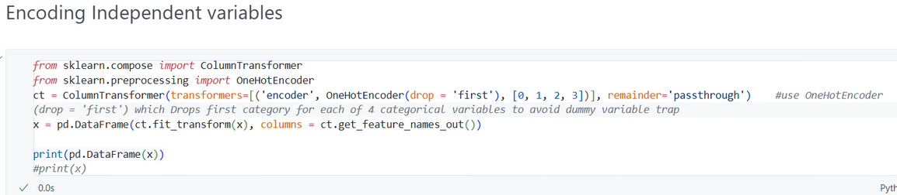
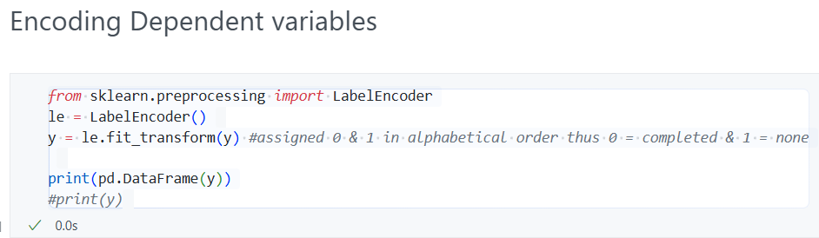
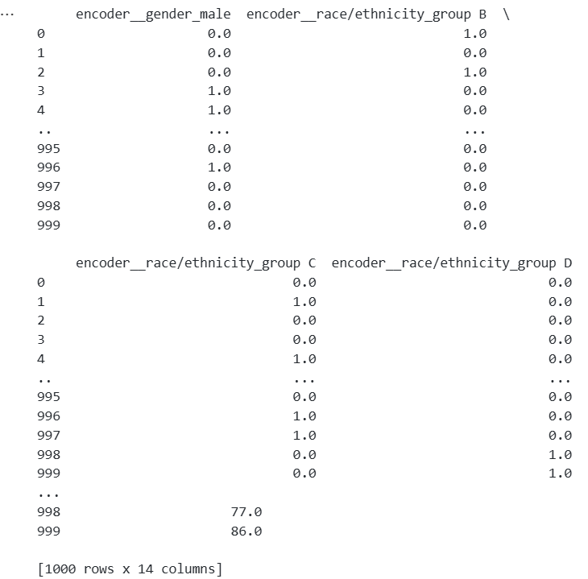
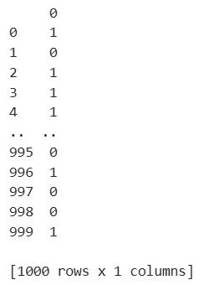
PREPROCESSING

Slide 10
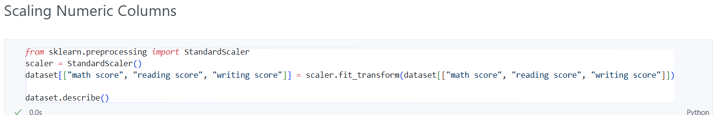
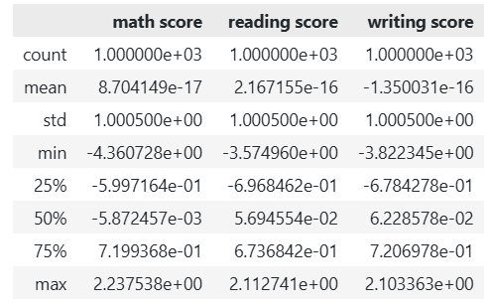
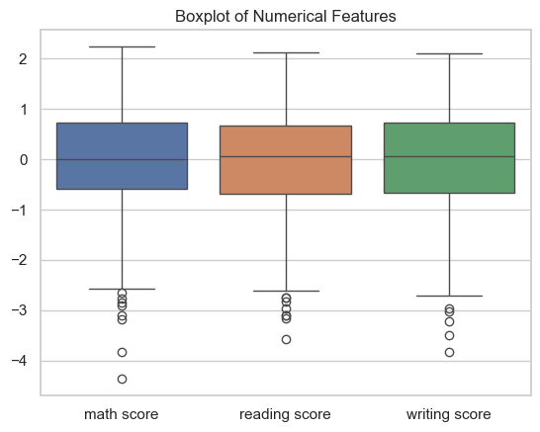
PREPROCESSING

Slide 11
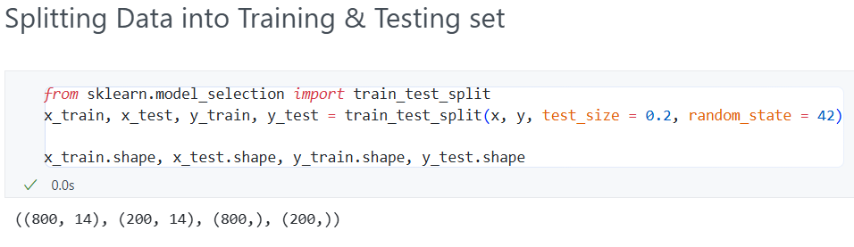

PREPROCESSING

Slide 12

LOGISTICS REGRESSION USING STATSMODEL.API
(WITHOUT HANDLING CLASS IMBALANCE)

Slide 13
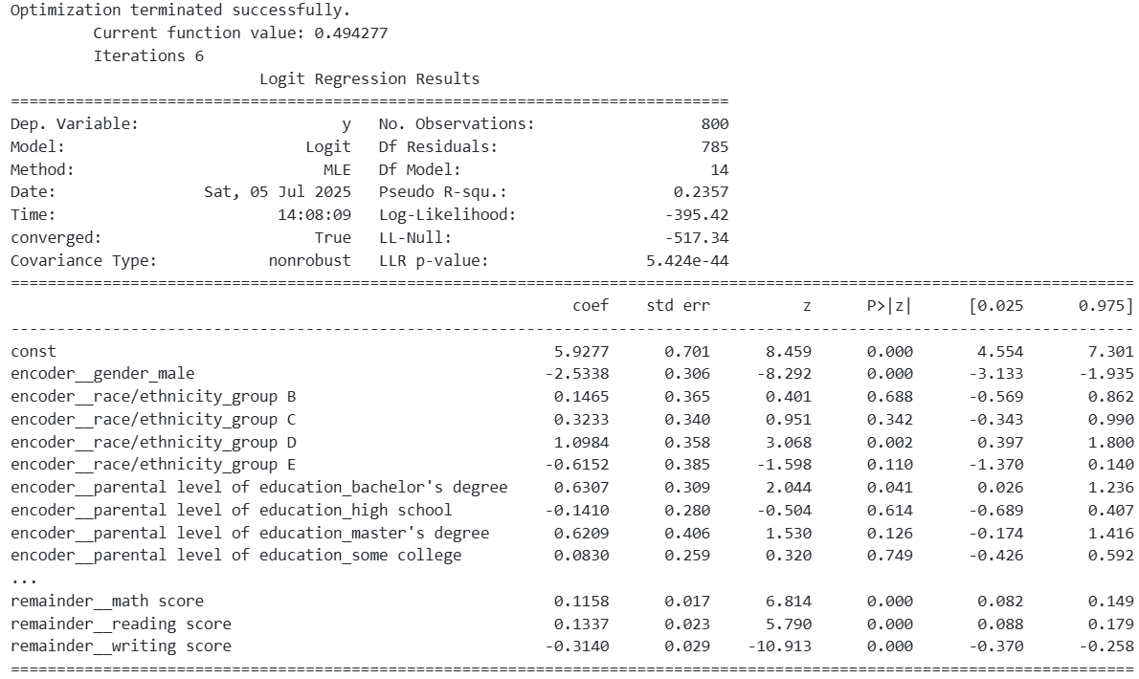
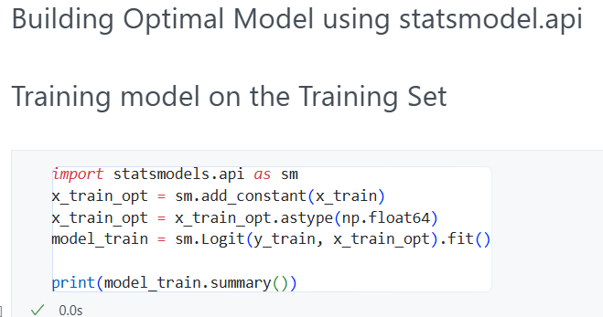
BULDING OPTIMAL MODEL

Slide 14
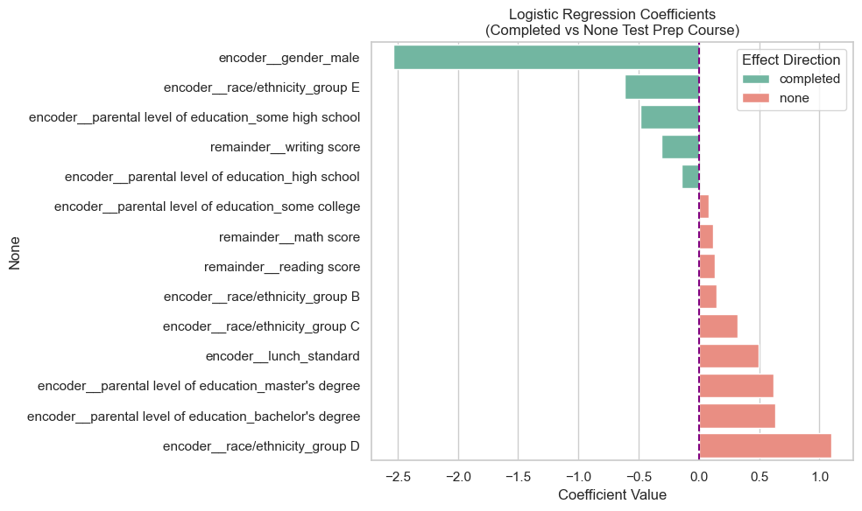

FEATURE IMPORTANCE

Slide 15
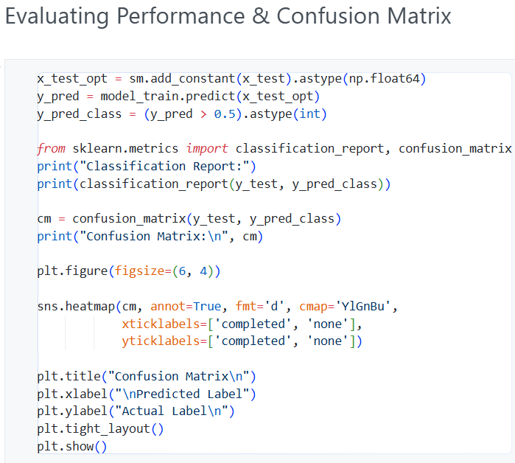
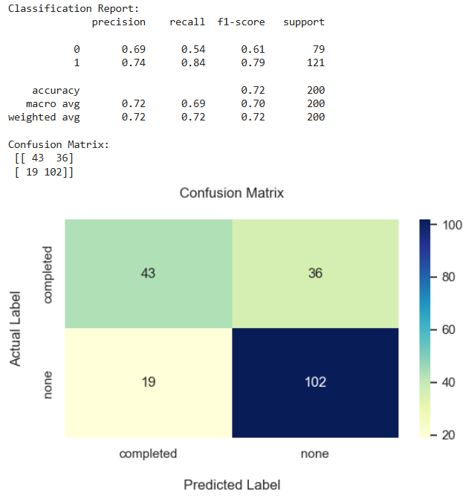
PERFORMANCE EVALUATION

Slide 16
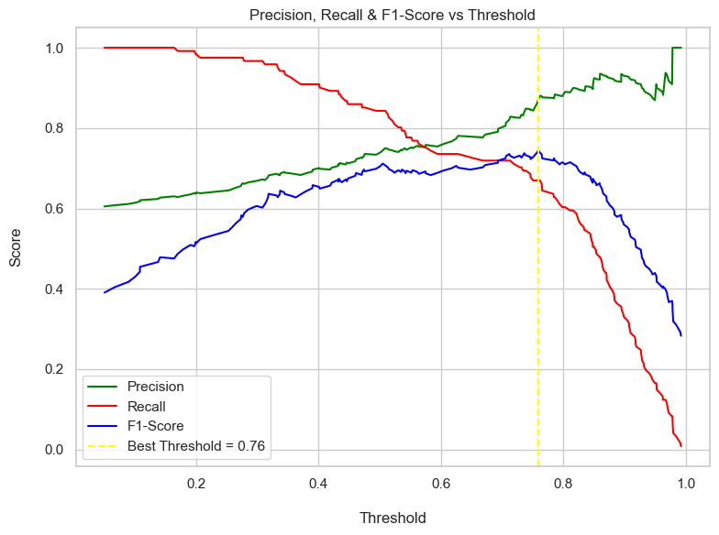
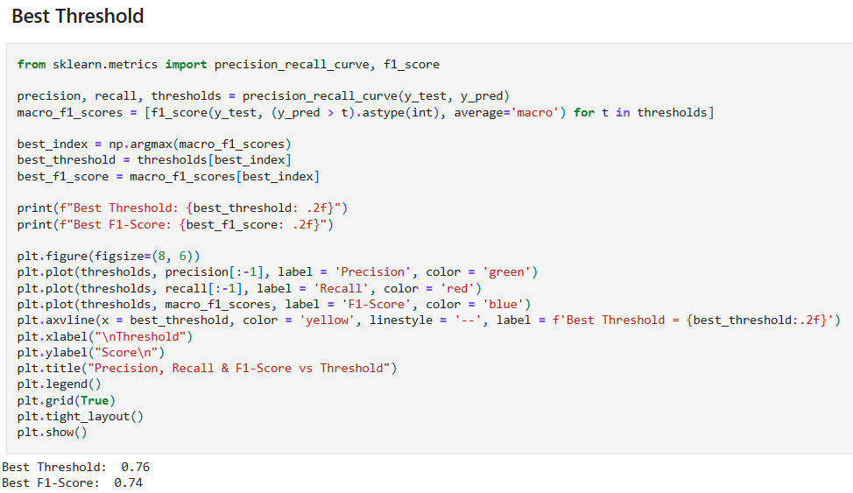
OPTIMAL THRESHOLD

Slide 17
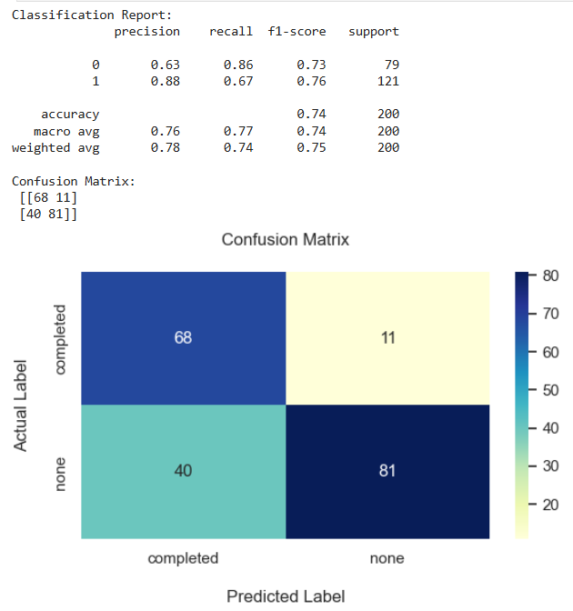
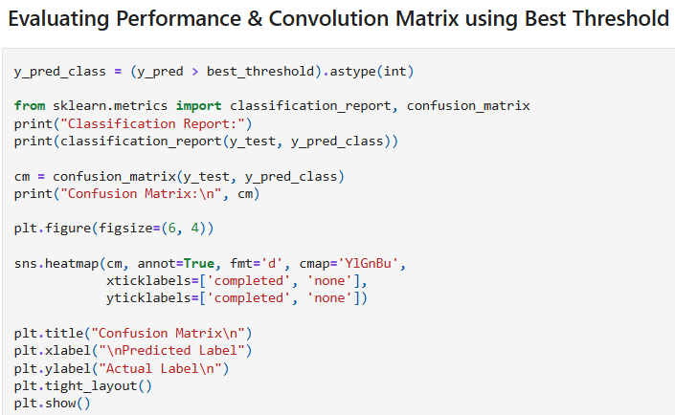
PERFORMANCE EVALUATION

Slide 18
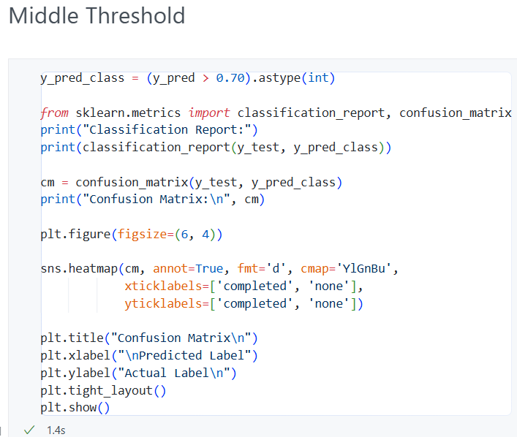
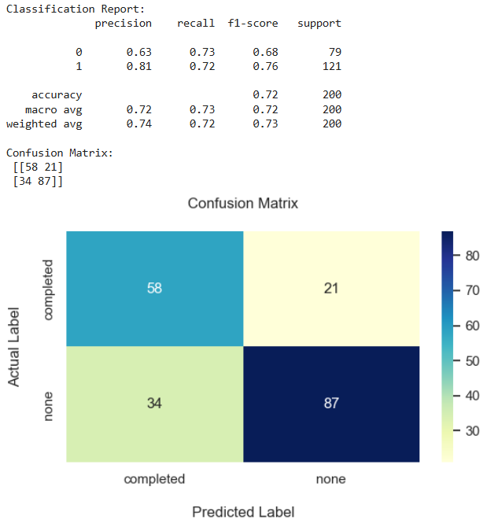
ARBITARY THRESHOLD

Slide 19
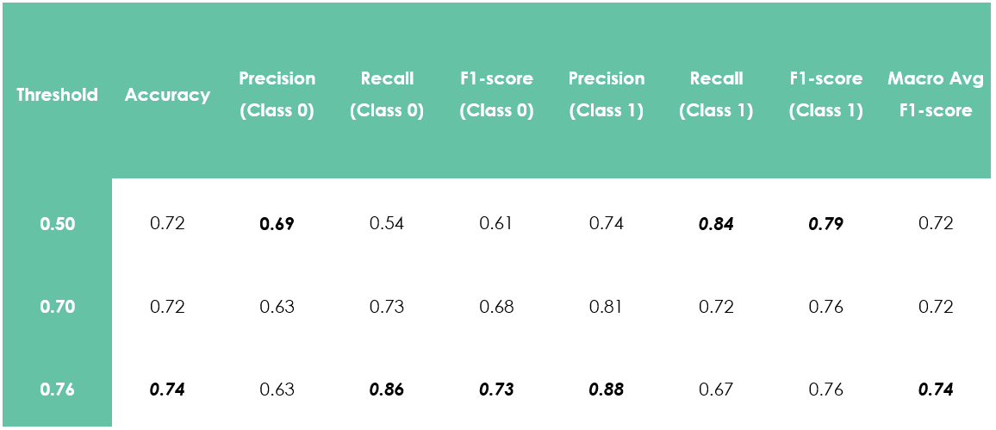
COMPARISON

Slide 20
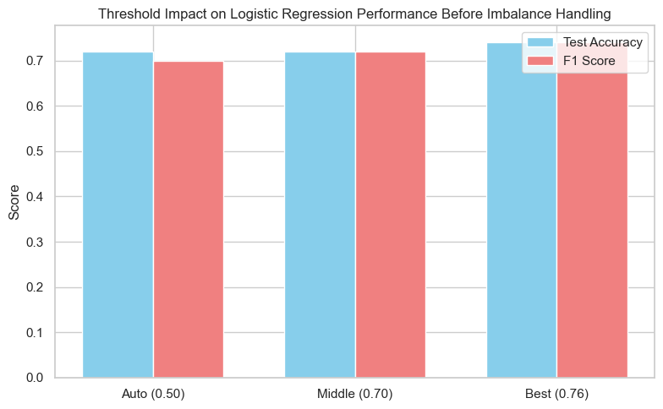
THRESHOLD IMPACT

Slide 21
LOGISTICS REGRESSION USING STATSMODEL.API
(AFTER HANDLING CLASS IMBALANCE)

Slide 22
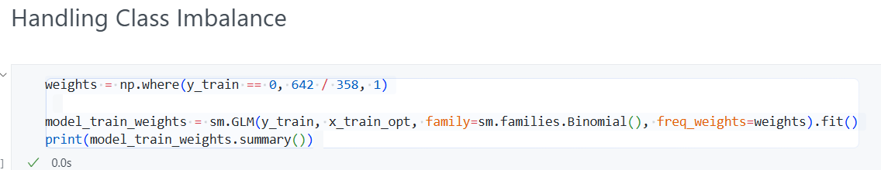
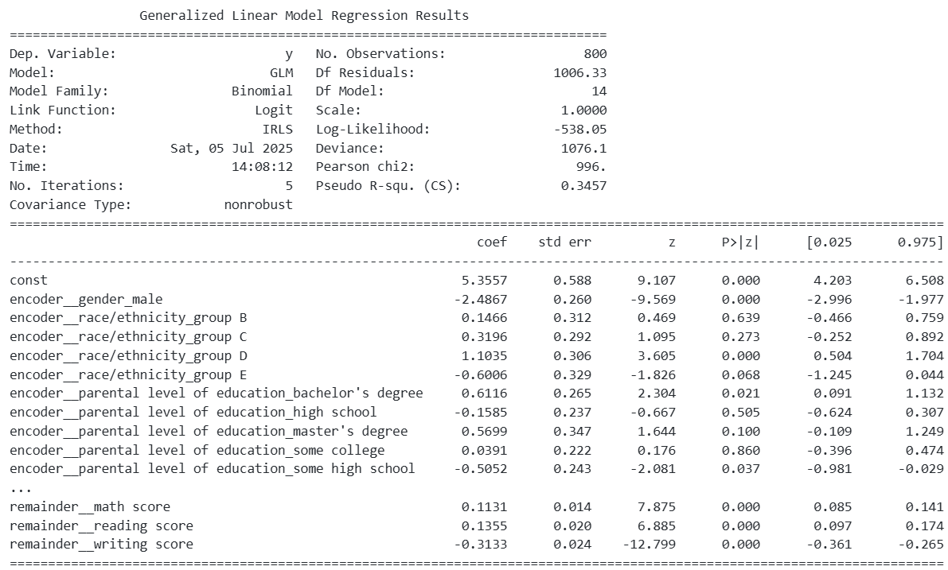
HANDLING CLASS IMBALANCE

Slide 23

FEATURE IMPORTANCE

Slide 24
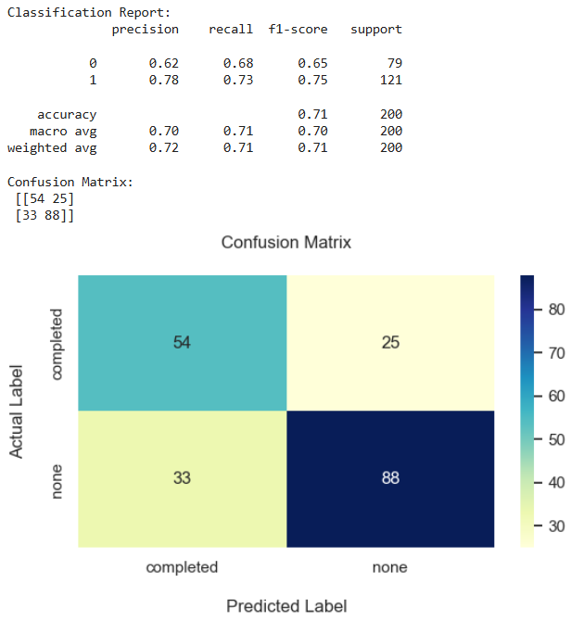
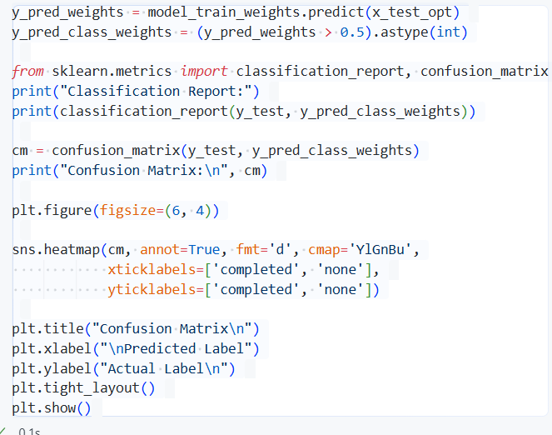
PERFORMANCE EVALUATION

Slide 25
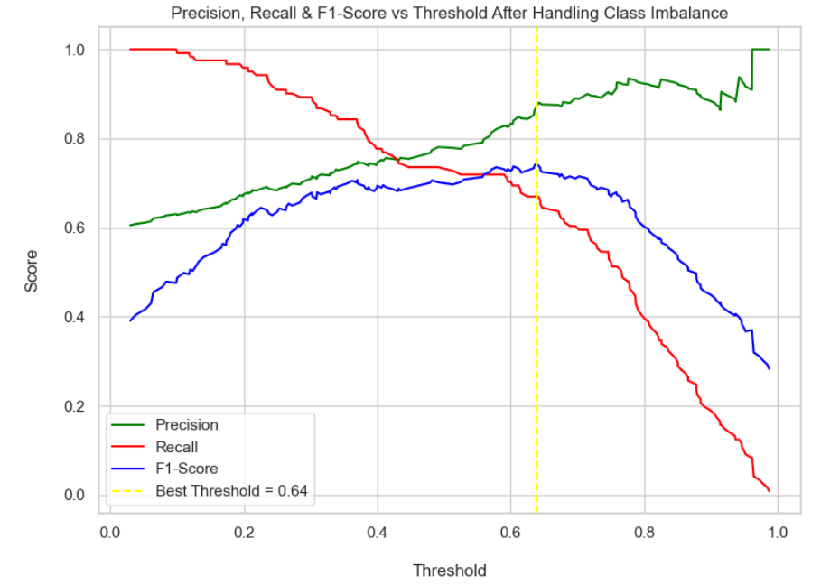
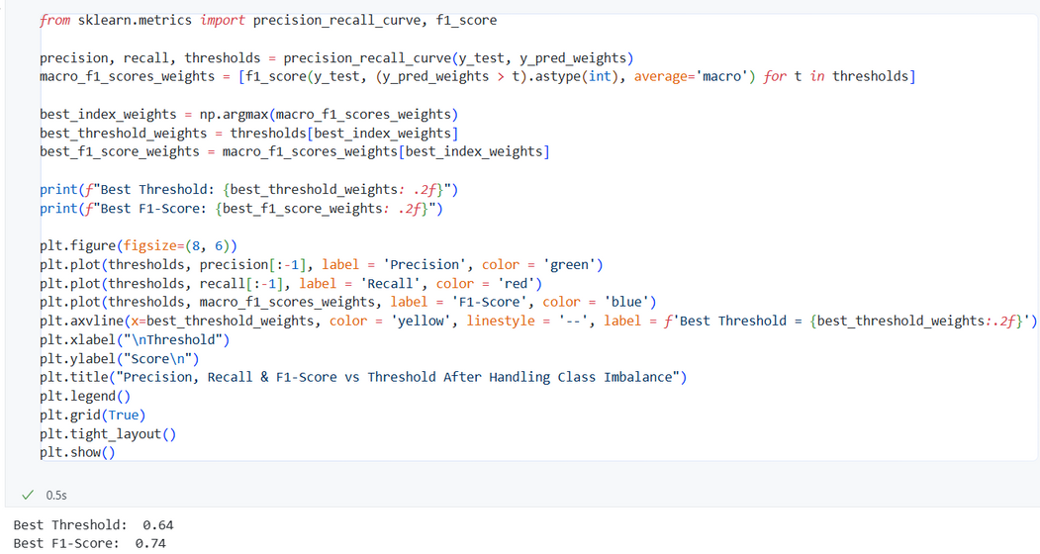
OPTIMAL THRESHOLD

Slide 26
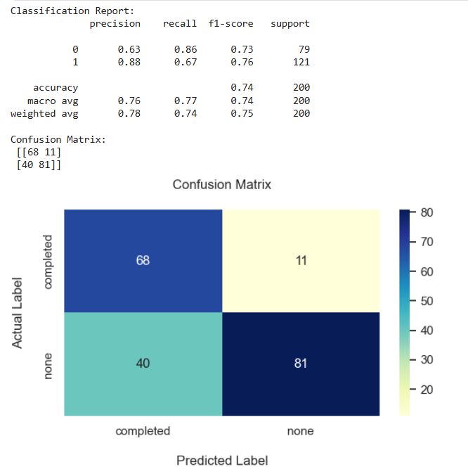
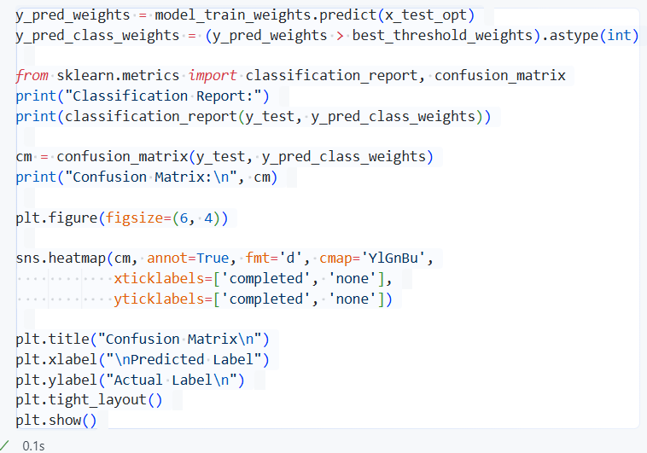
PERFORMANCE EVALUATION

Slide 27
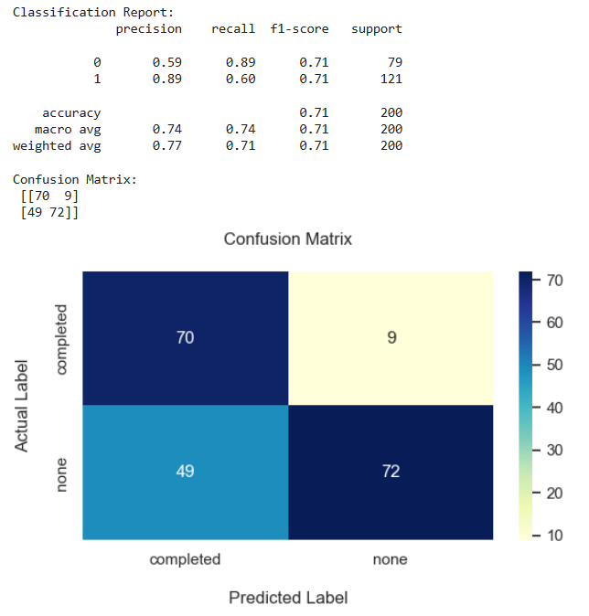
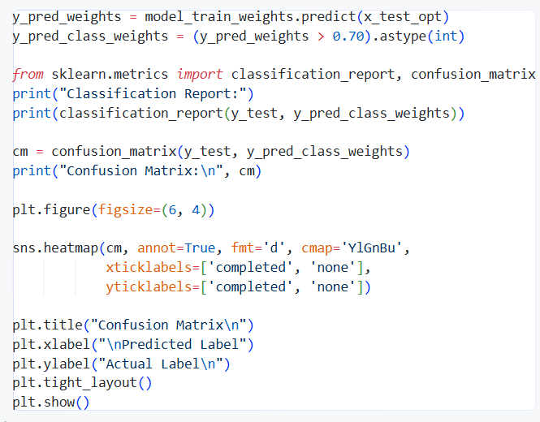
ARBITARY THRESHOLD

Slide 28
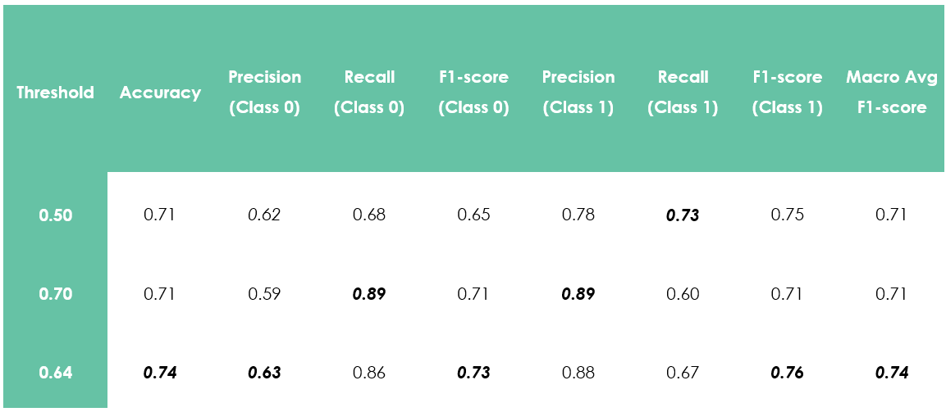
COMPARISON

Slide 29
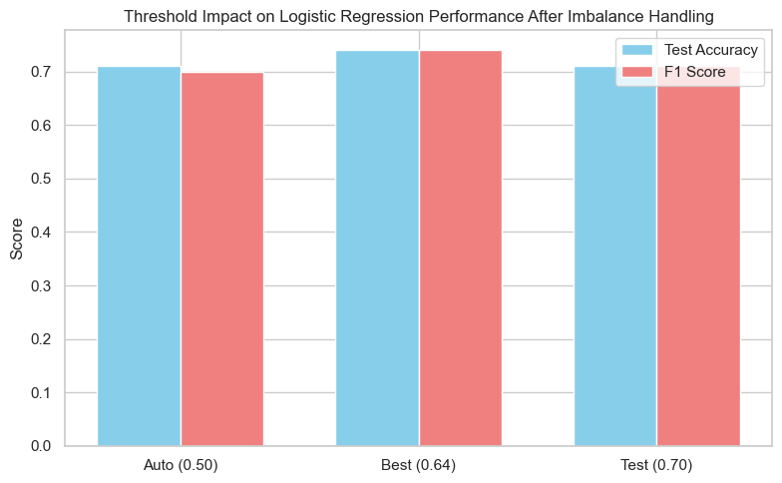
THRESHOLD IMPACT

Slide 30
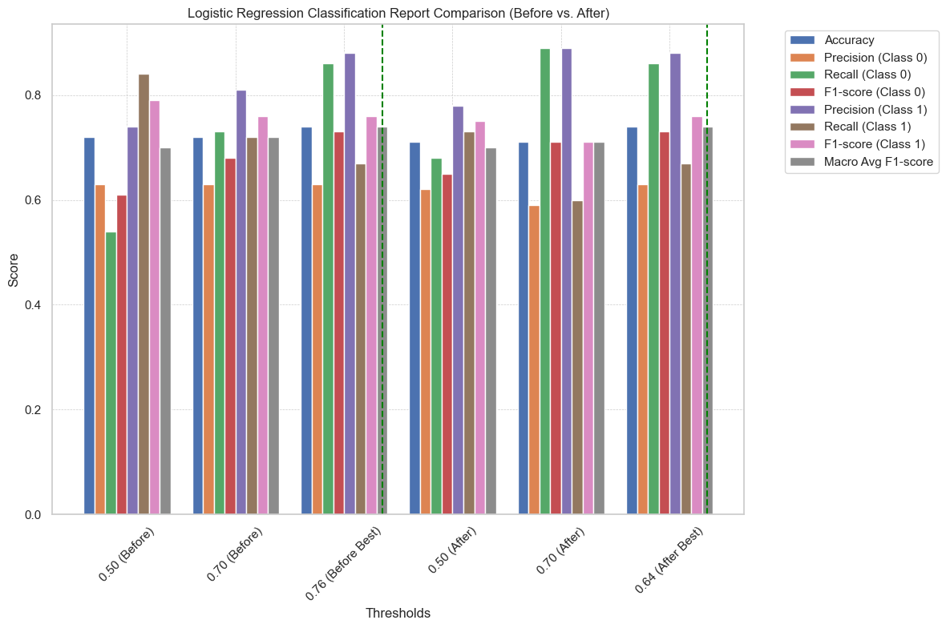
OVERALL COMPARISON

Slide 31
IMPLEMENTING DIFFERENT MODELS
(DT, RF, SVM, KNN)

Slide 32
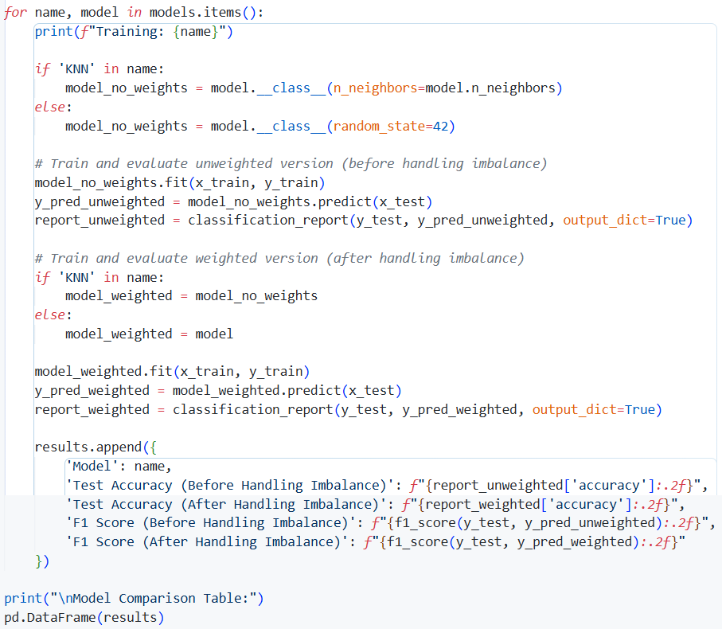

MODEL COMPARISON

Slide 33



MODEL COMPARISON

Slide 34
CROSS
VALIDATION

Slide 35


CROSS VALIDATION (5)

Slide 36


CROSS VALIDATION (5)

Slide 37


CROSS VALIDATION (5)

Slide 38


CROSS VALIDATION (10)

Slide 39

CV COMPARISON

Slide 40
MANUAL
PREDICTION

Slide 41





Slide 42


CONCLUSION
For Logistic Regression, at threshold 0.76 before imbalance handling & at threshold 0.64 after imbalance handling provides similar & best results for both scenarios
Without Cross validation, Logistic Regression provides the overall best & stable performance in both scenarios followed by KNN(n=11)
With Cross Validation (5), Logistic Regression is the best & balanced model followed by SVM considering LR’s consistency & SVM’s high F1-score
For Cross Validation (10), Logistic Regression trumps keeping SVM at 2nd for the similar reason

Slide 43

BANGLADESH UNIVERSITY OF PROFESSIONALS
THANK
YOU
FOR YOUR ATTENTION

Slide 44

BANGLADESH UNIVERSITY OF PROFESSIONALS
DO YOU HAVE ANY QUESTION

